Slide 1
Alabama Hydrangea Society Tours
May and June 2017
Photos by by Sandi Falkenhagen, Sydney Ellis, Teresa Boody, Jennifer Gregory, David Doggett and from Southern Living magazine

Slide 2
Jim Scott’s Garden
May 10, 2017
Alabama Hydrangea Society Tour

Slide 3
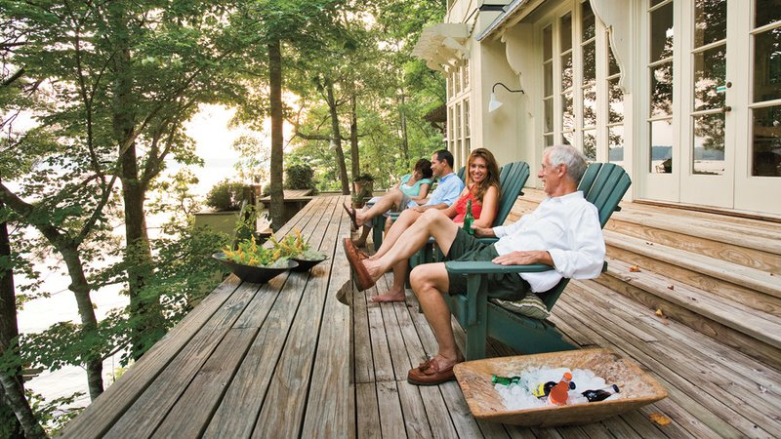
Photos from Southern Living magazine

Slide 4
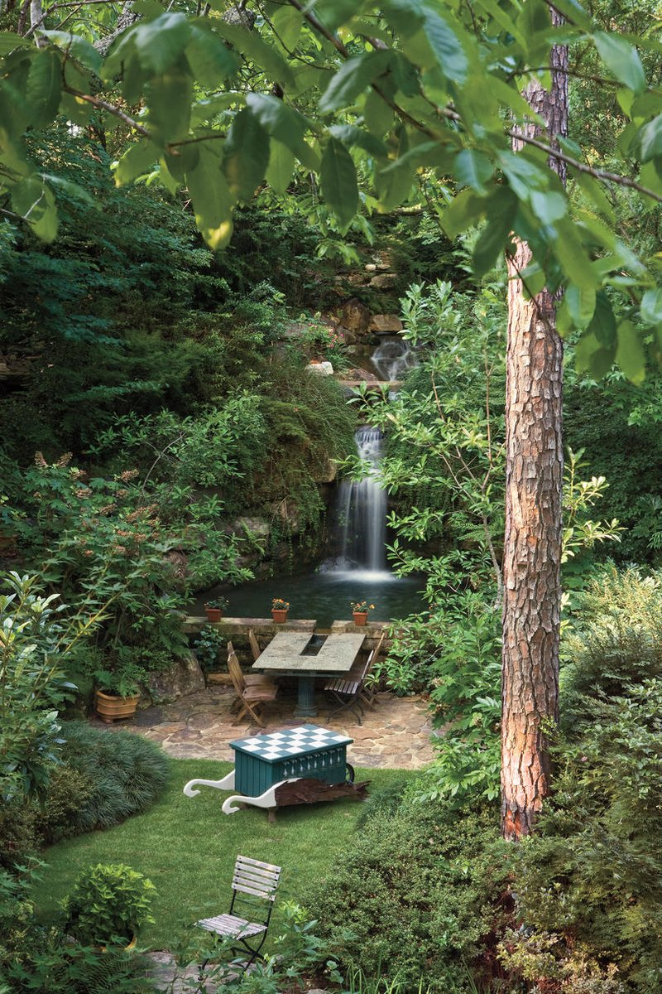
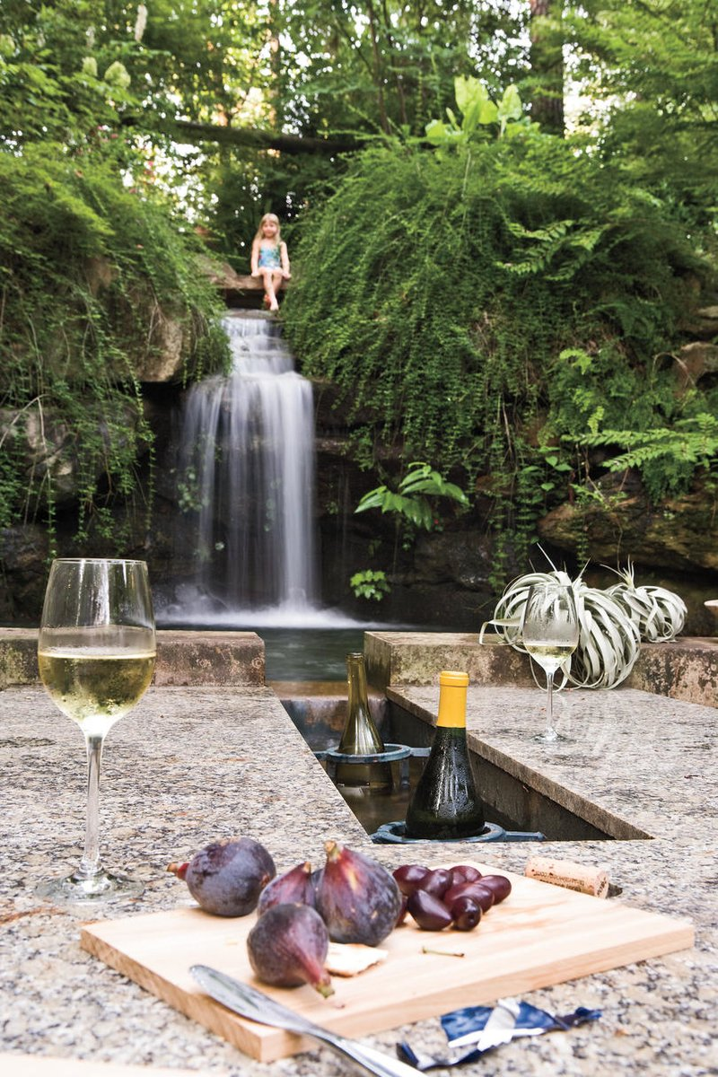

Slide 5
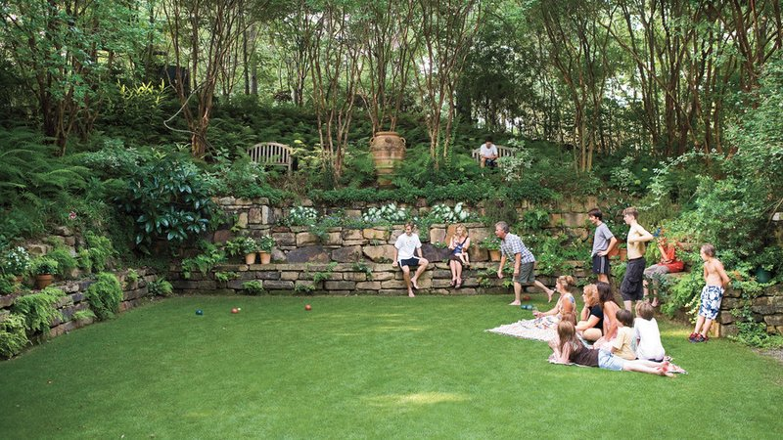

Slide 6
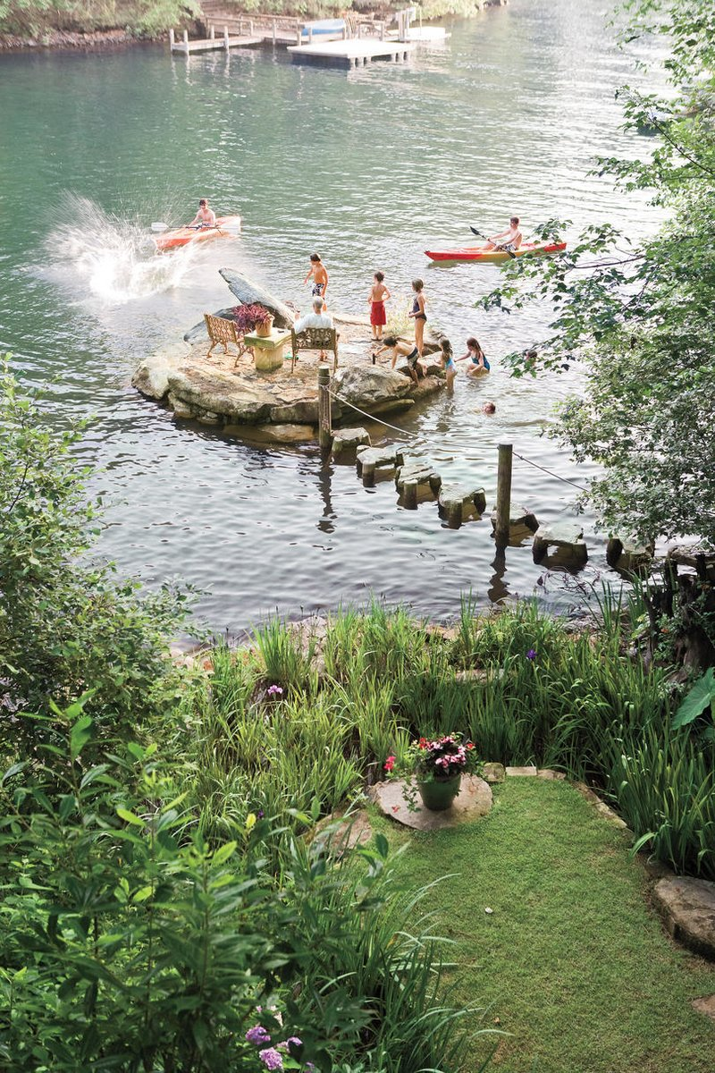
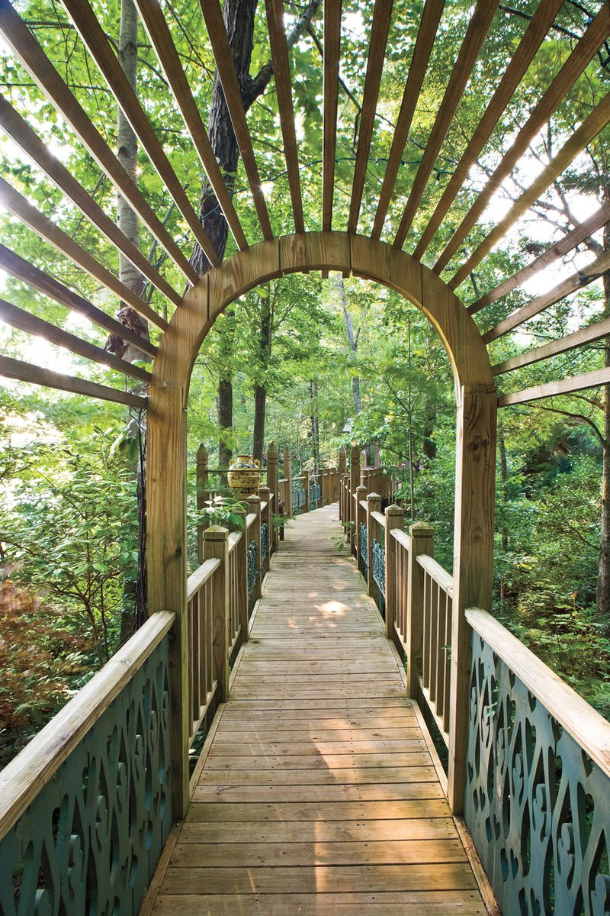

Slide 7
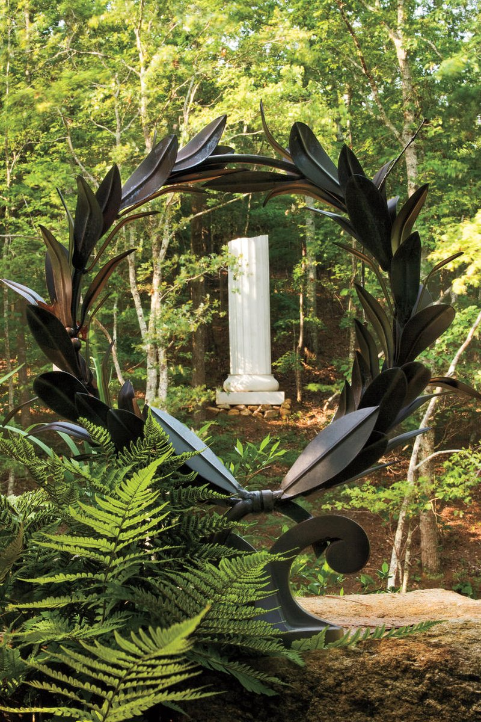
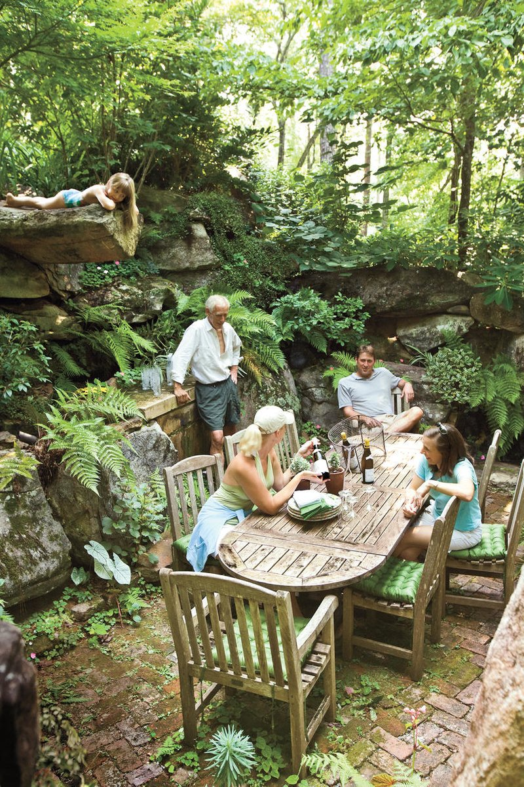

Slide 8
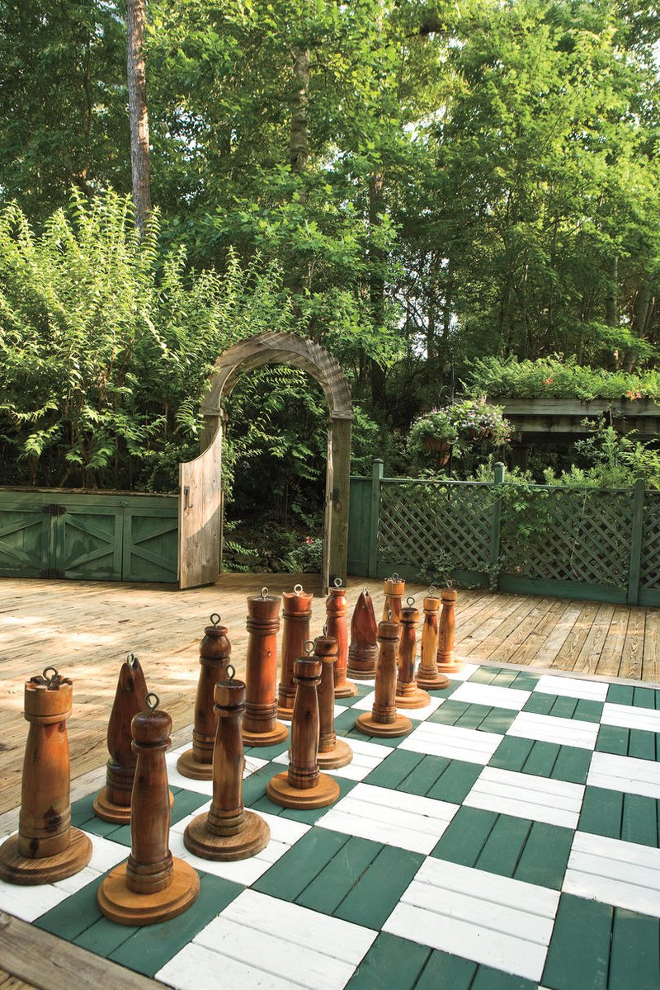
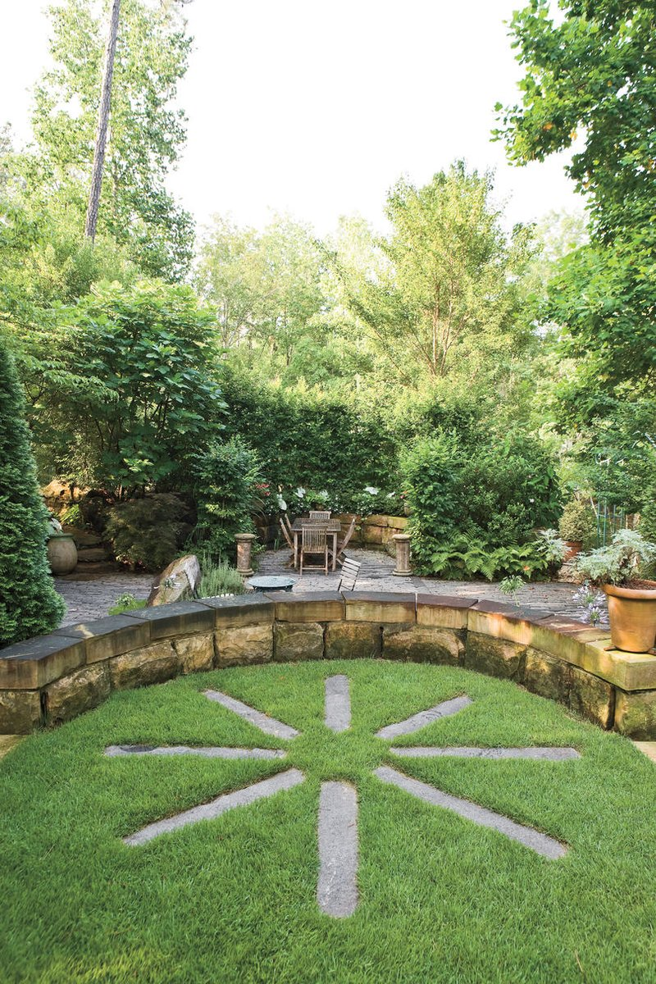

Slide 9
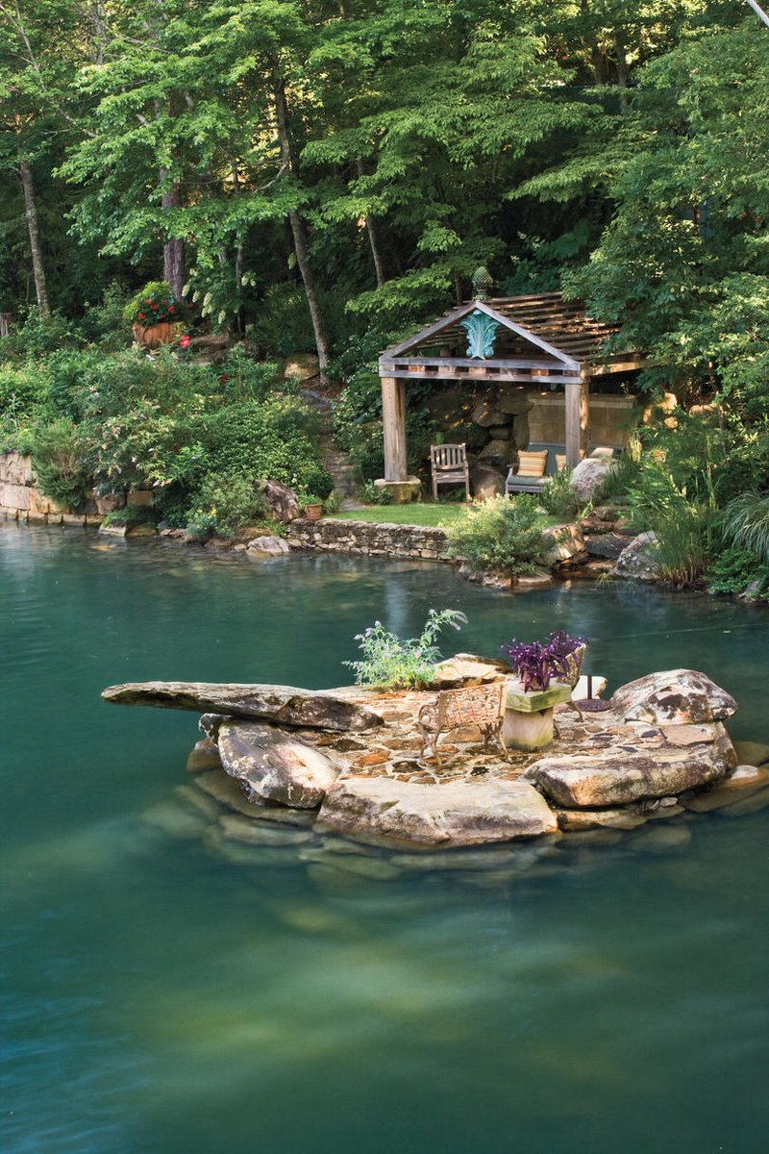
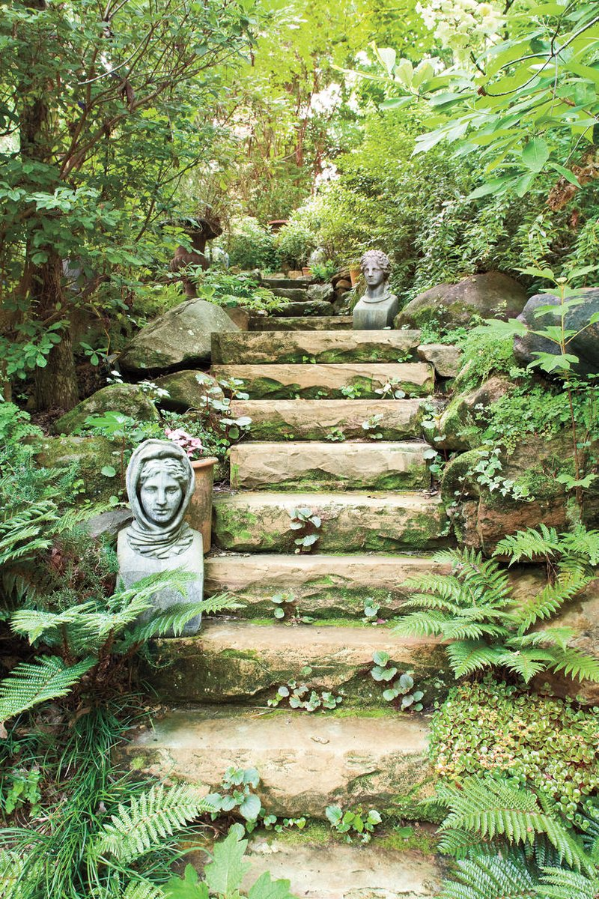

Slide 10
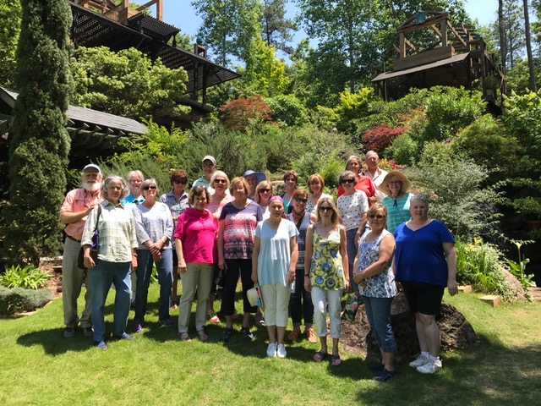
The AHS Group

Slide 11
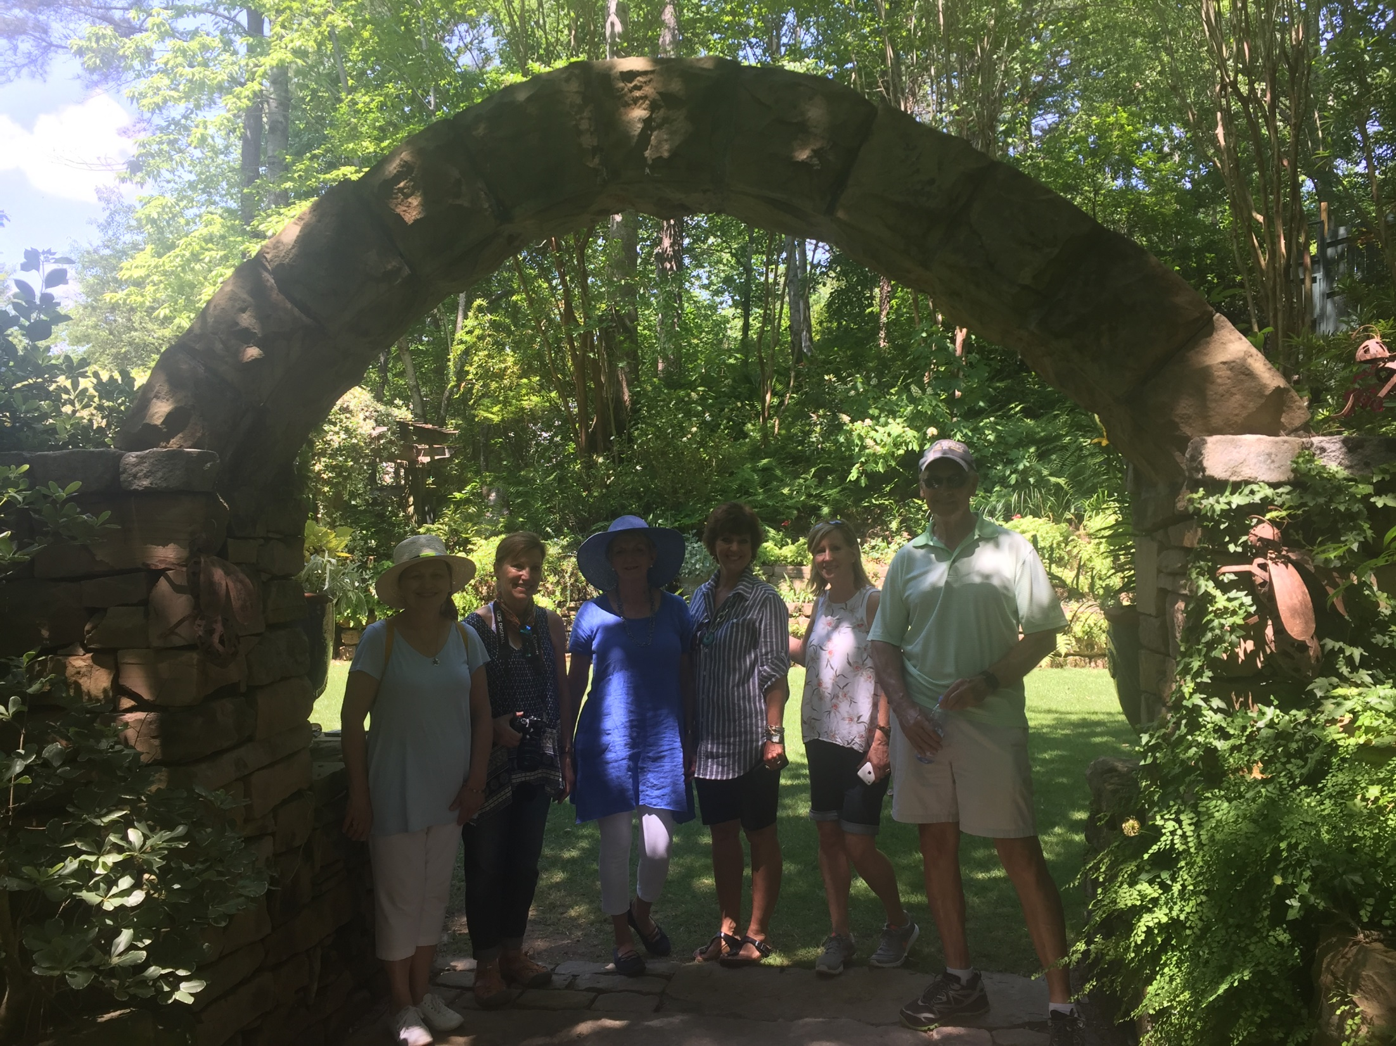

Slide 12
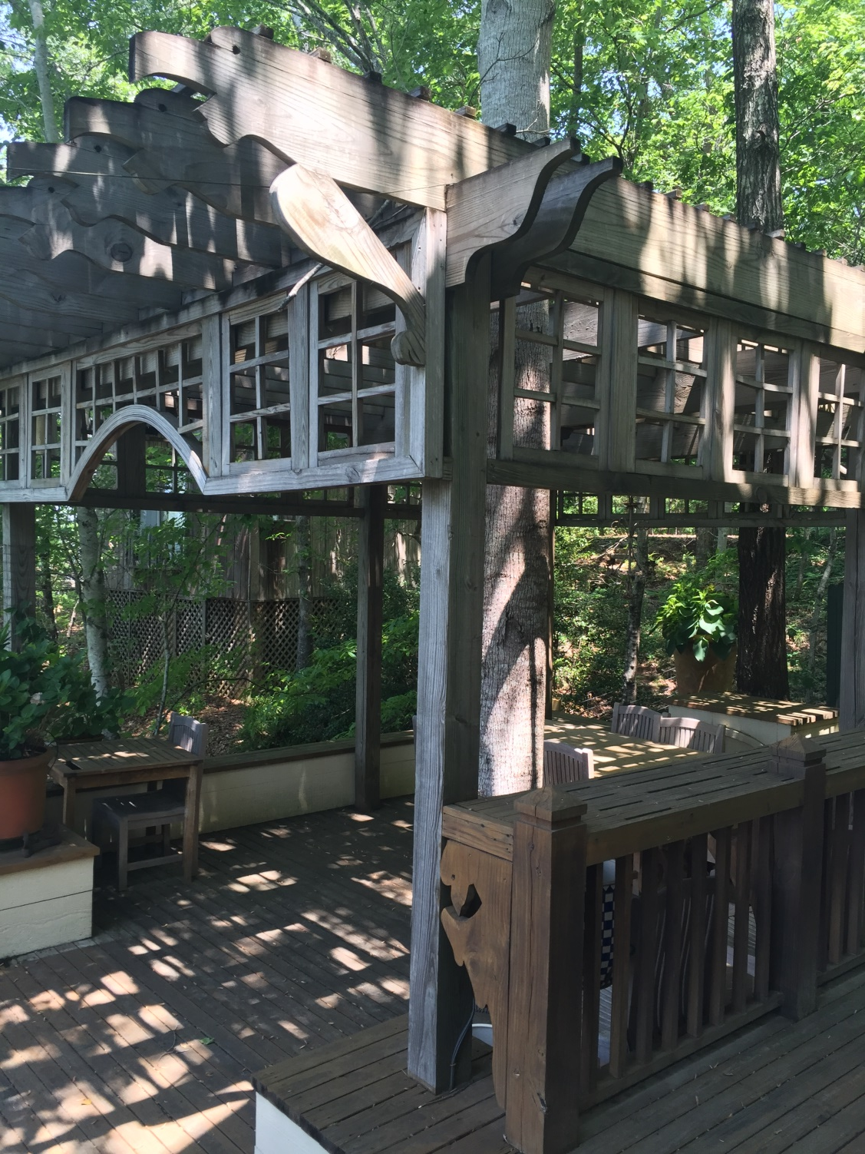
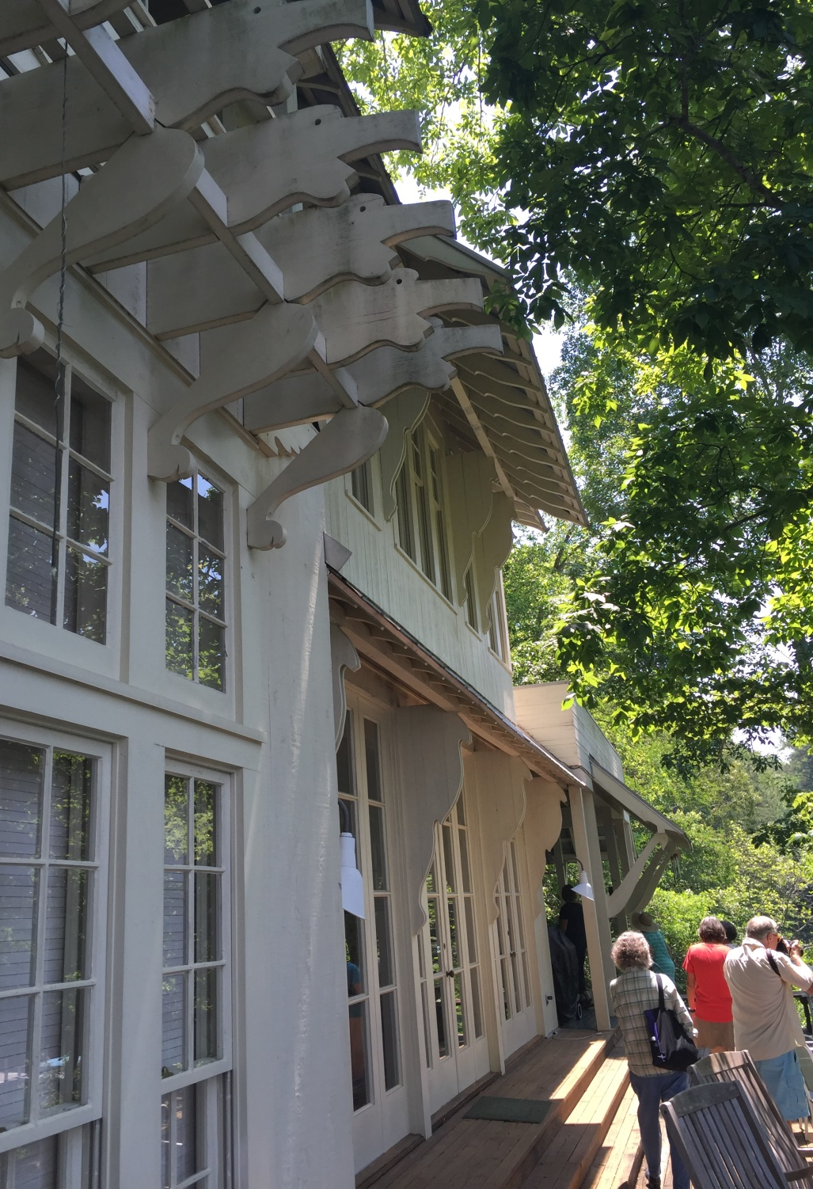

Slide 13
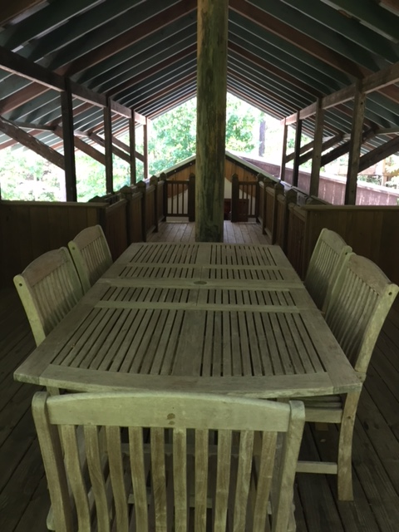
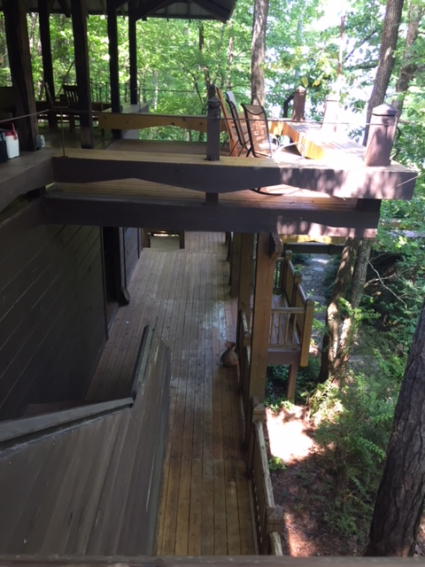

Slide 14
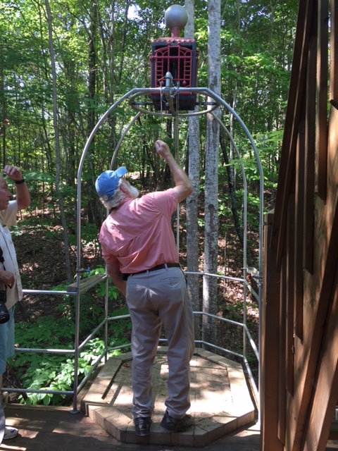

Slide 15
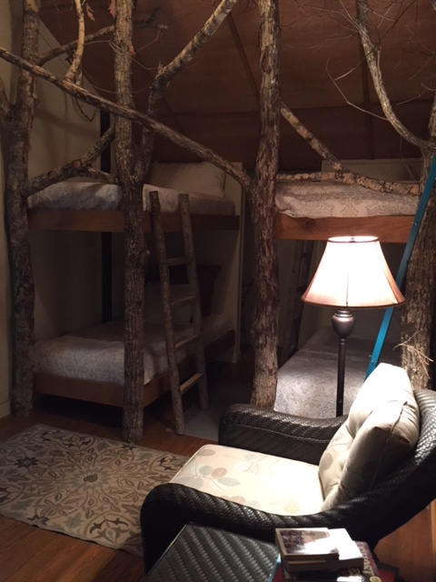
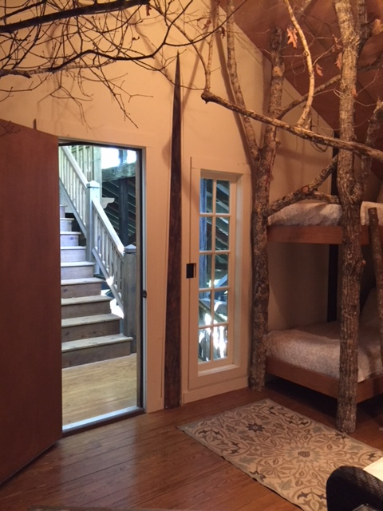

Slide 16
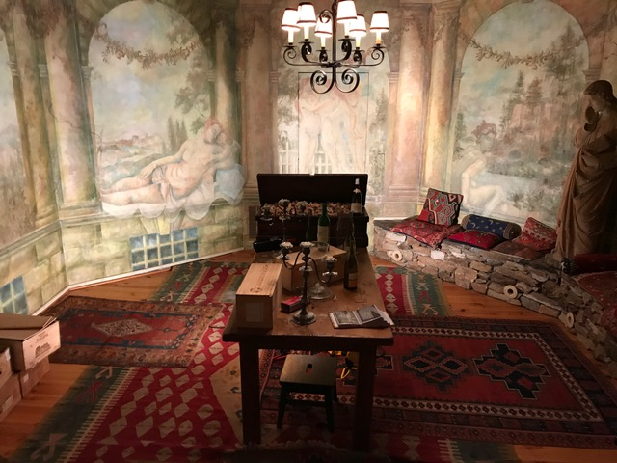

Slide 17
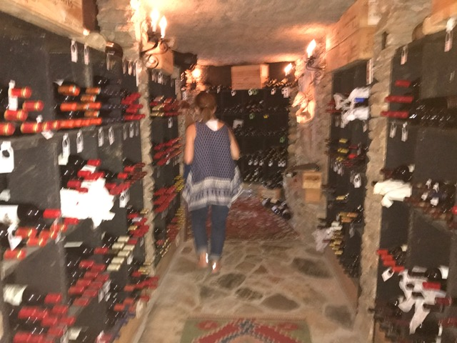

Slide 18
Landscape Design Tip
Feature Natural Elements Such as Rocks, Water, Lake

Slide 19
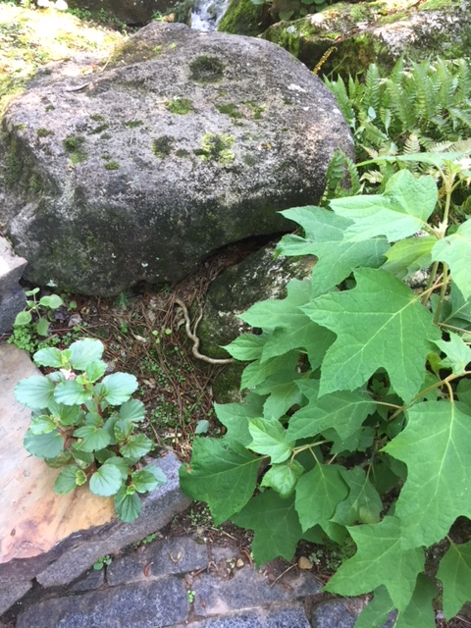
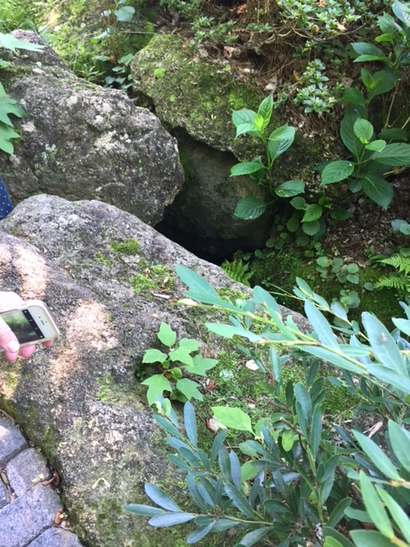

Slide 20
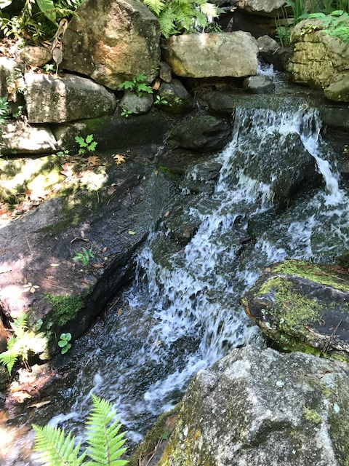
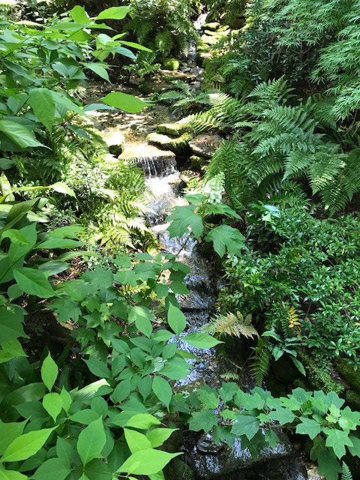

Slide 21
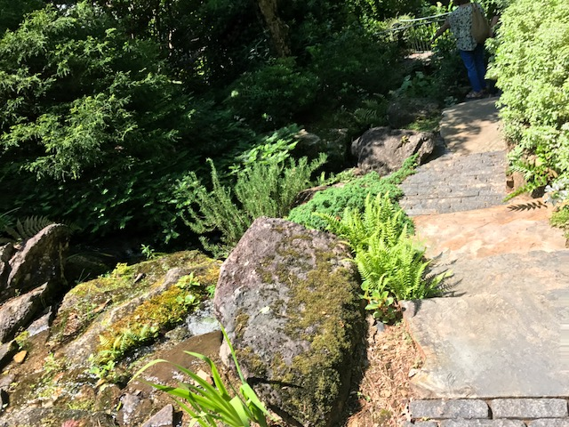

Slide 22
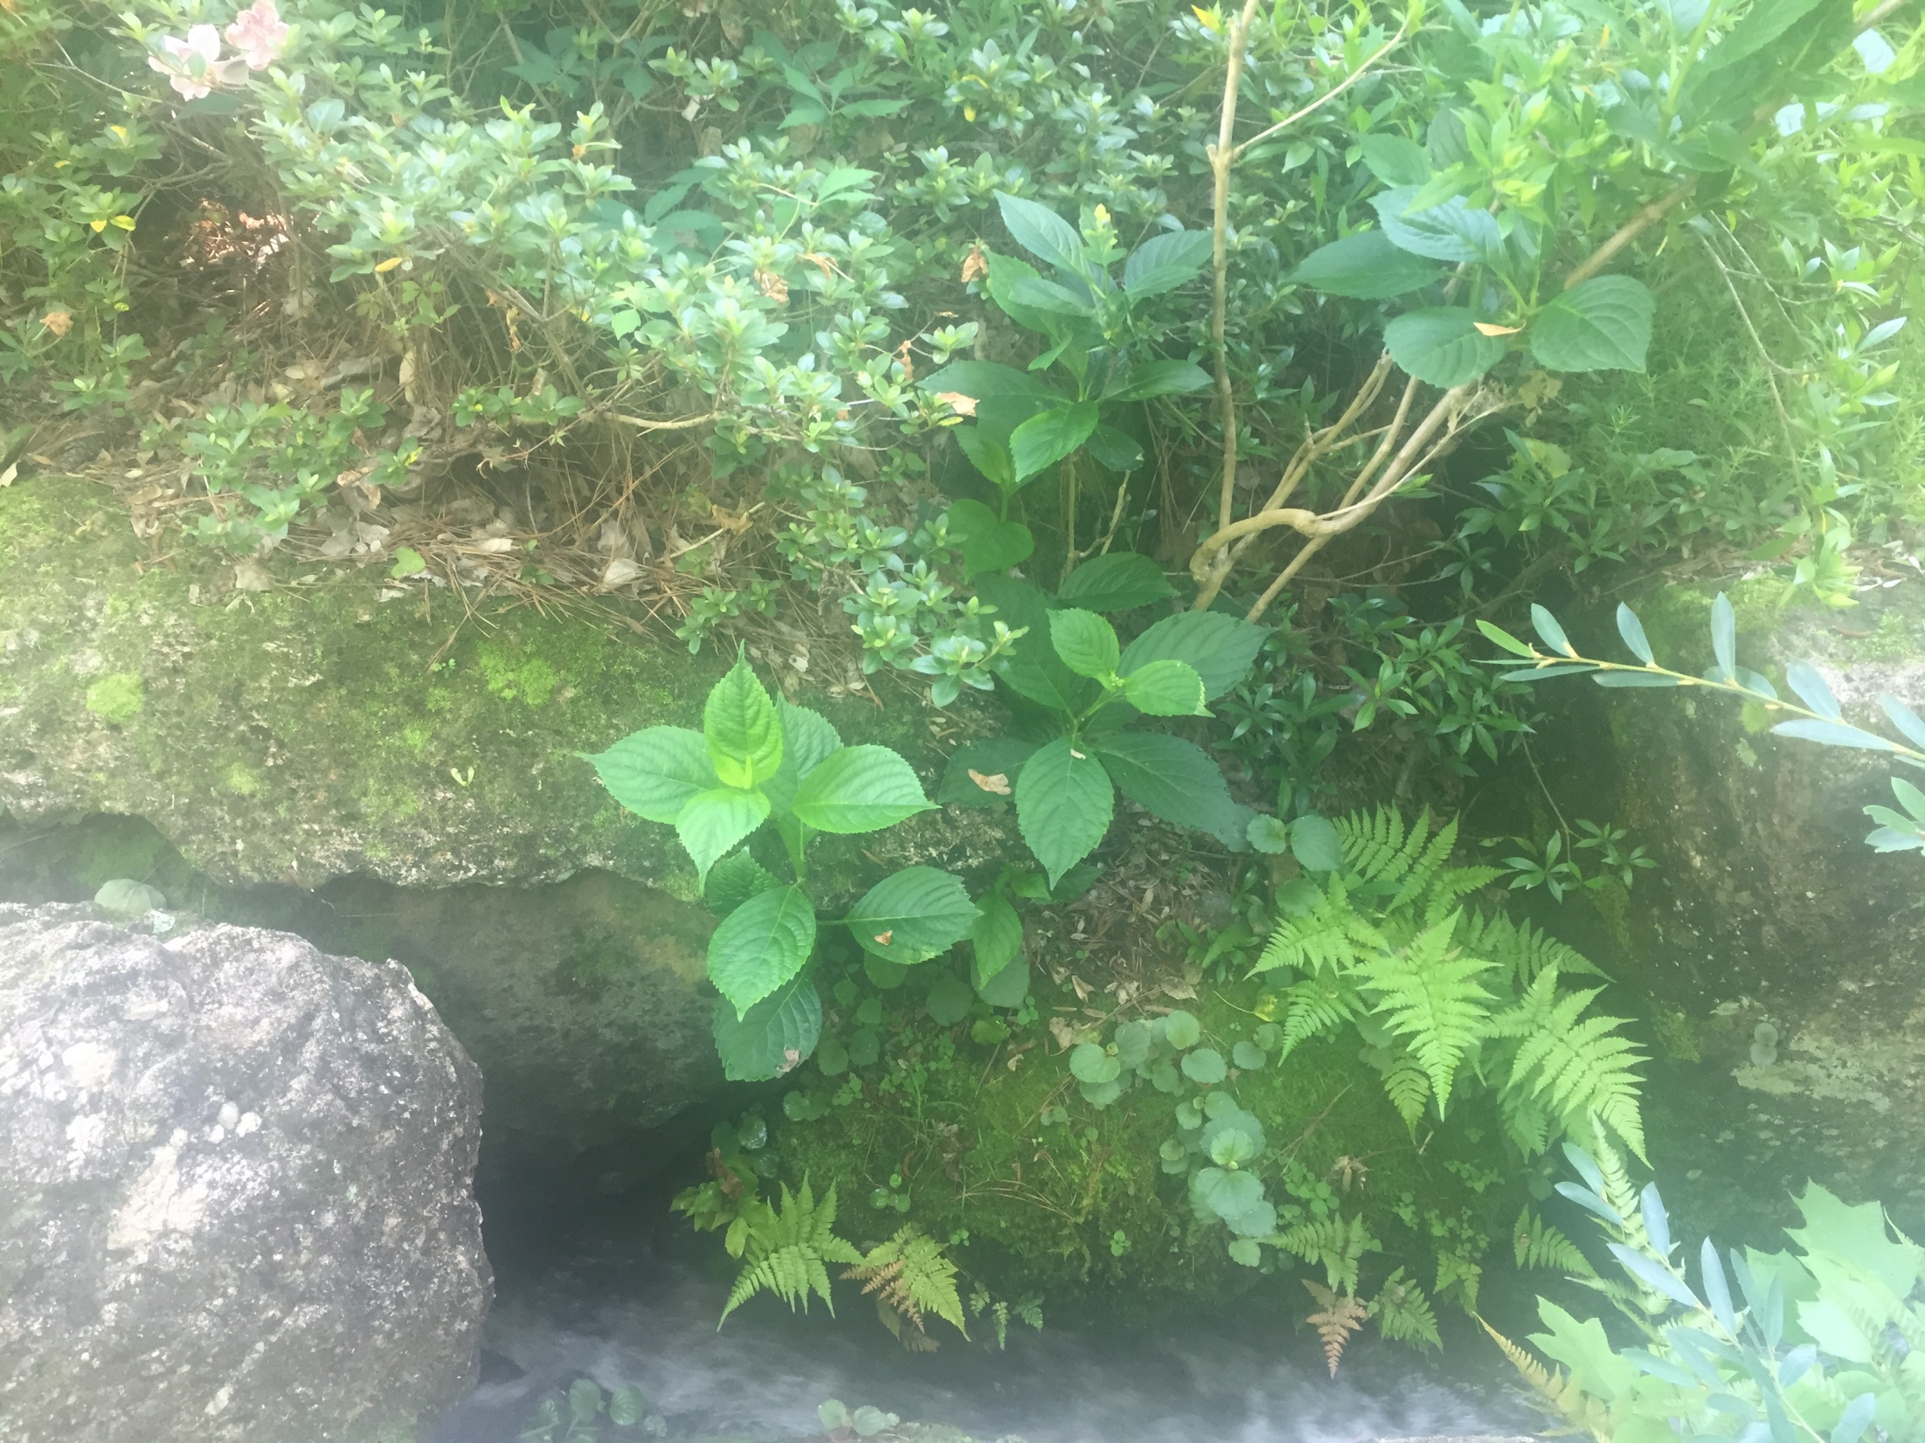

Slide 23
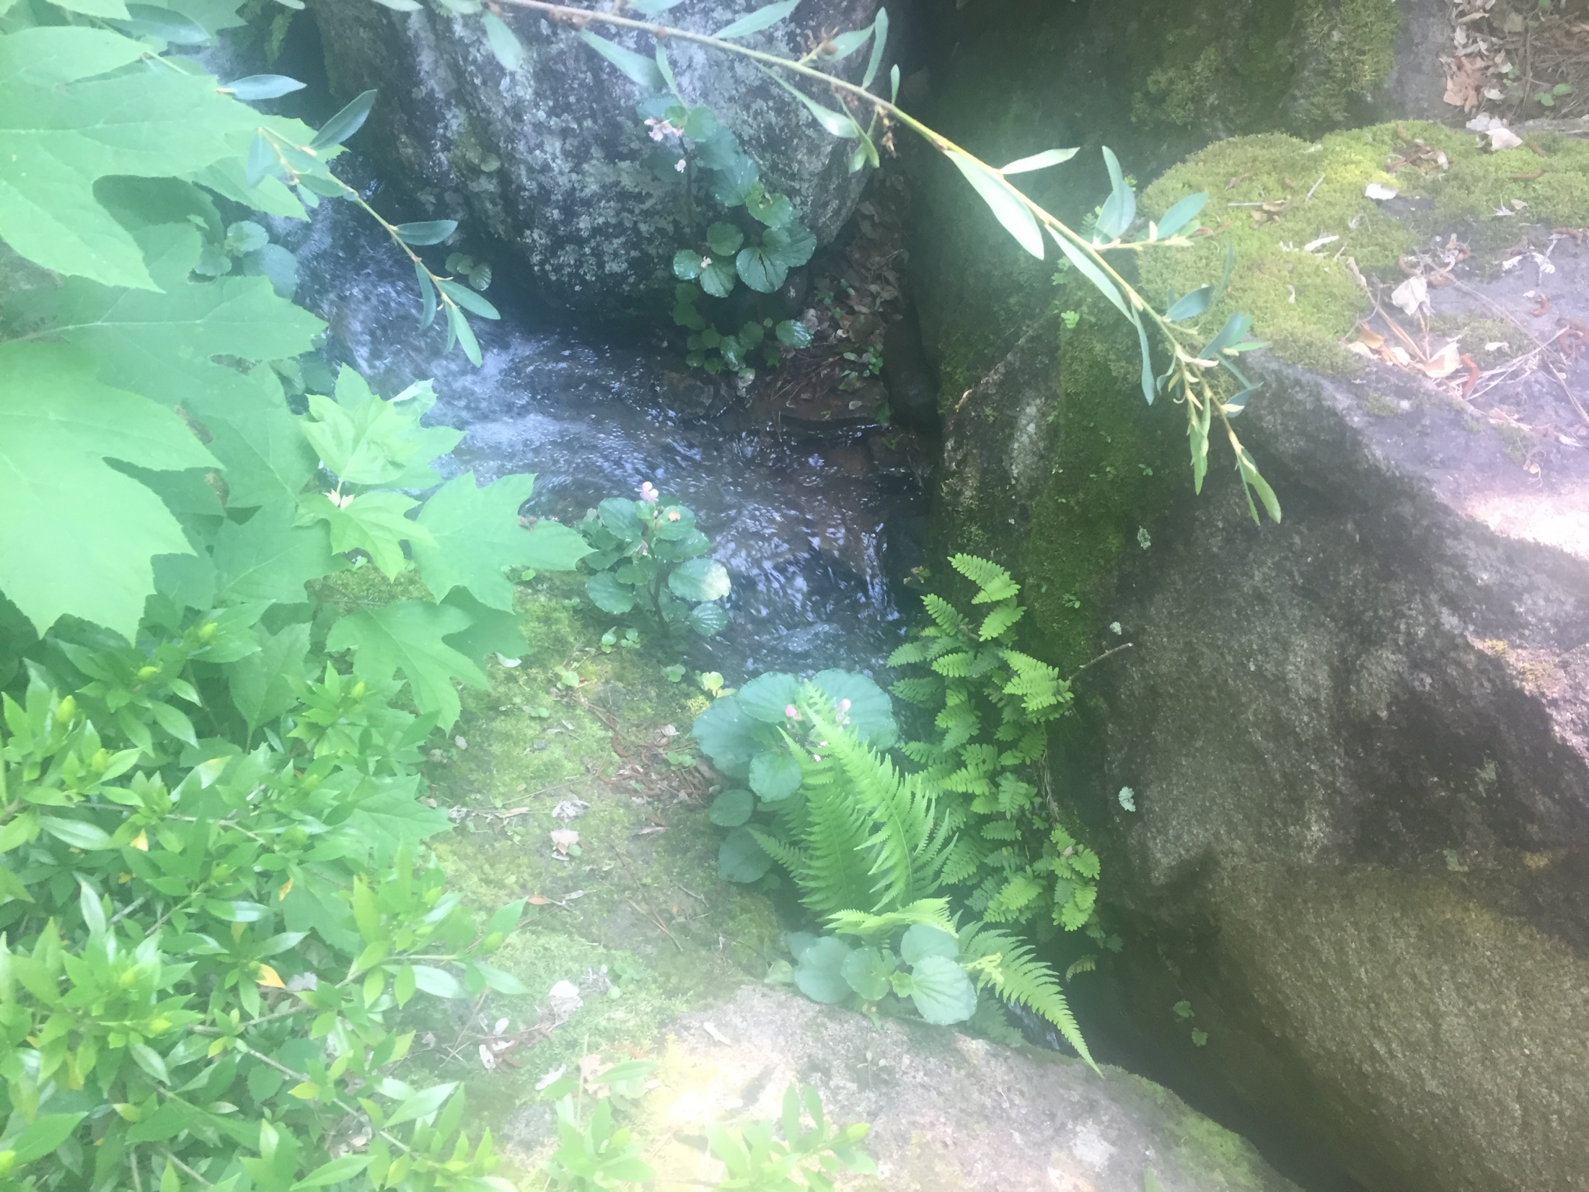

Slide 24
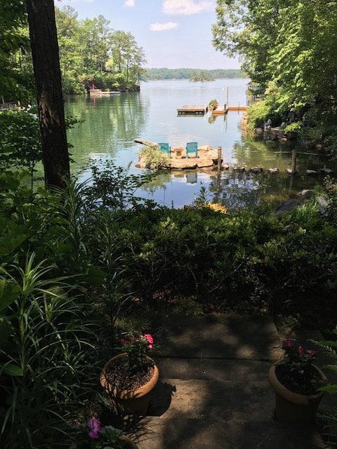
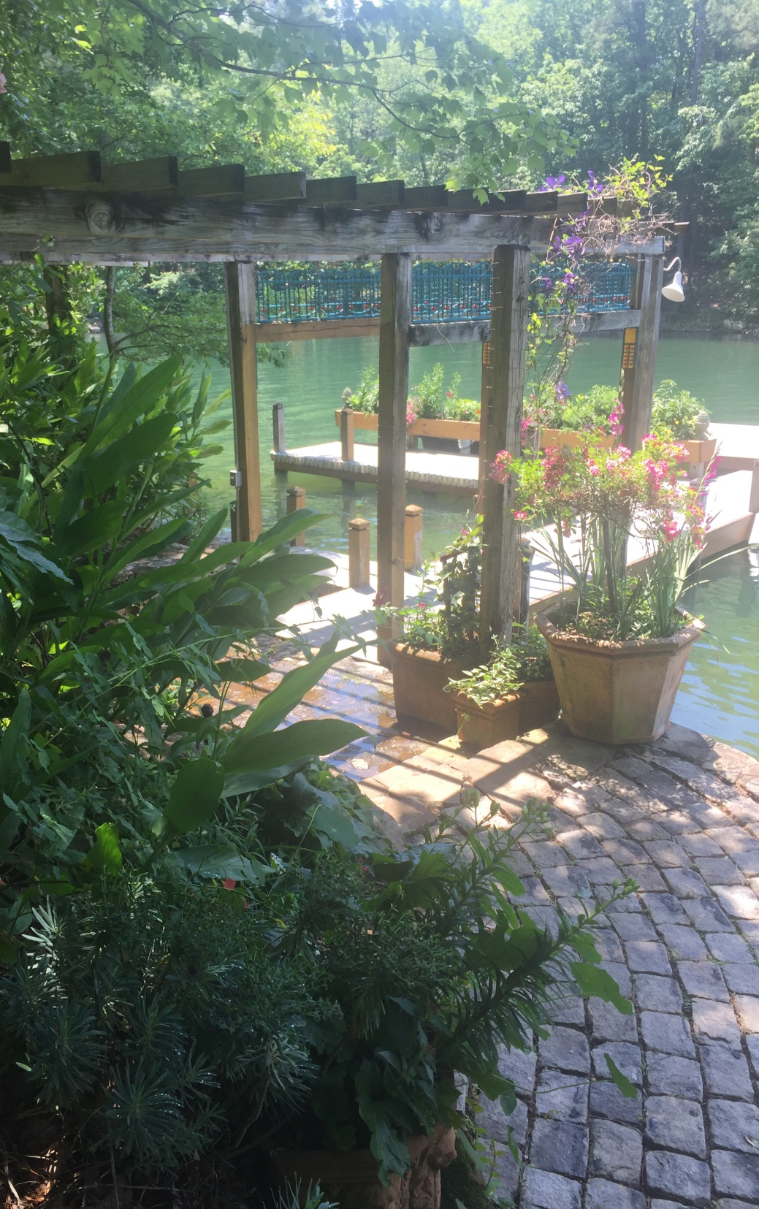

Slide 25
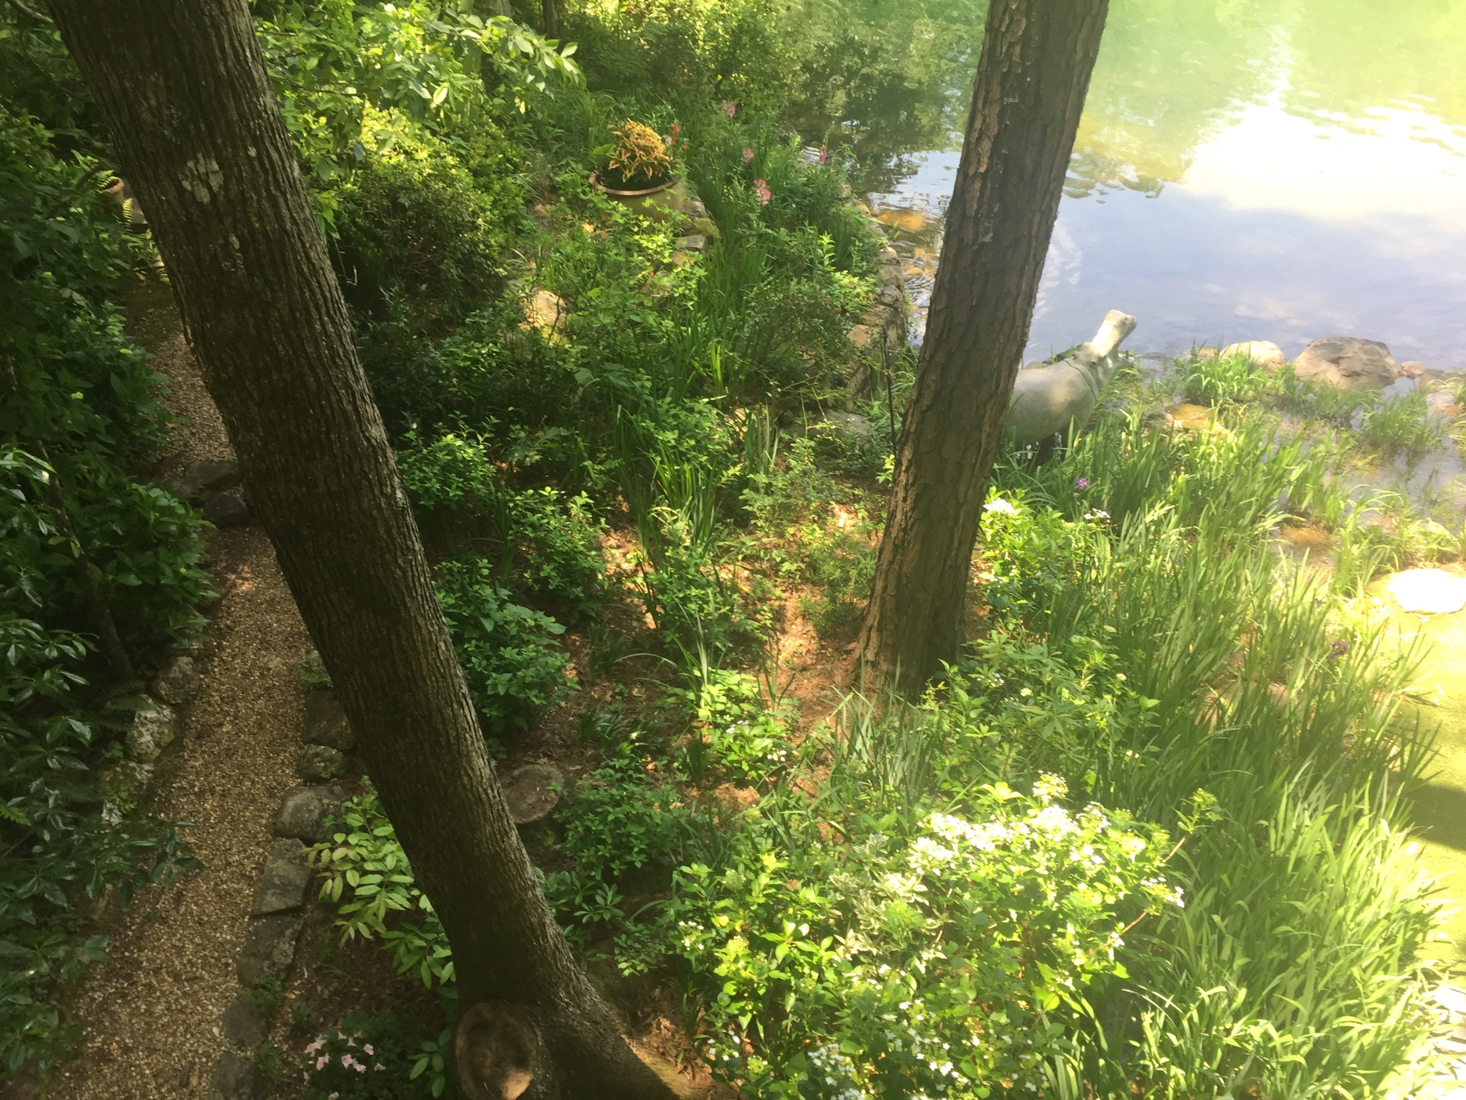

Slide 26
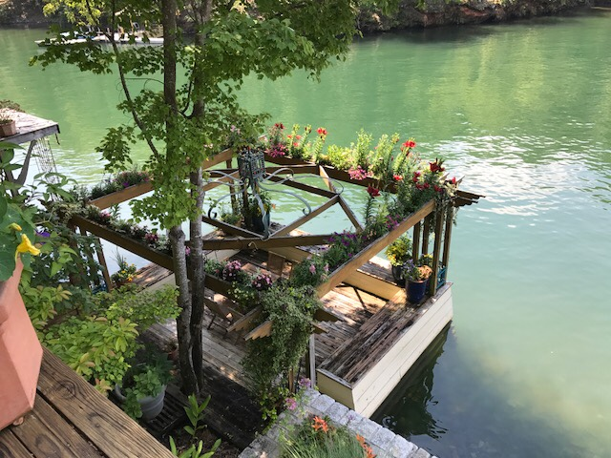

Slide 27
Landscape Design Tip
Gardens Should Have Focal Points and Objects of Interest

Slide 28
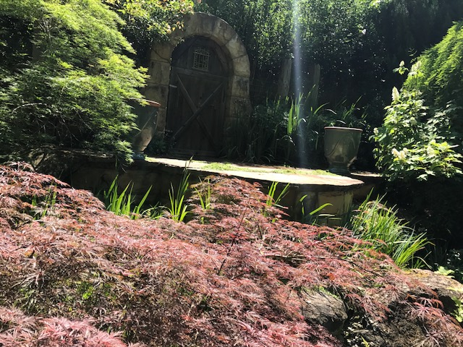

Slide 29
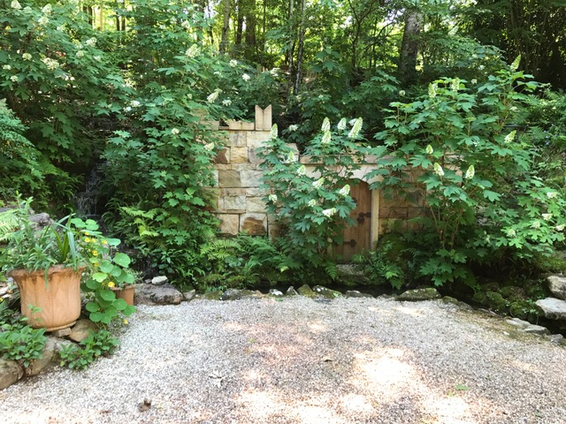

Slide 30
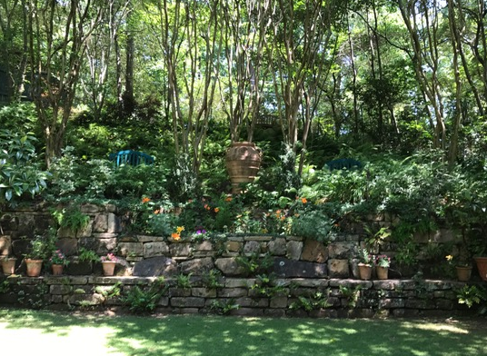

Slide 31
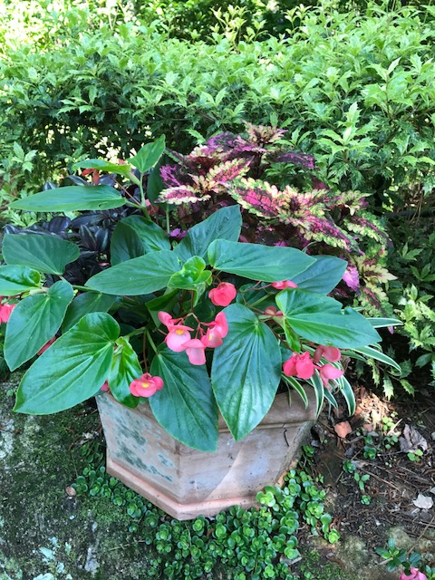
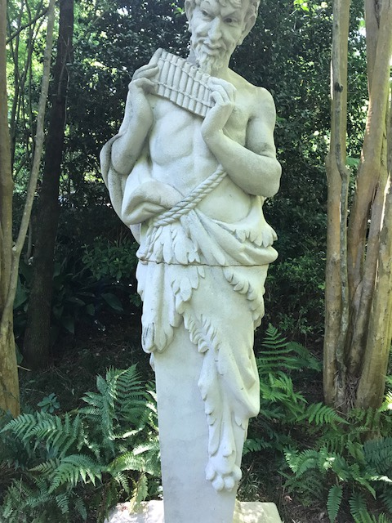

Slide 32
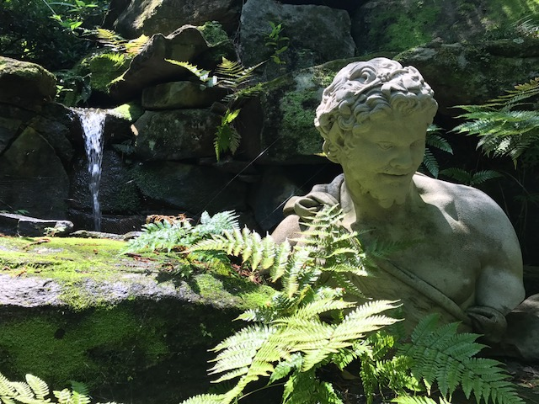

Slide 33
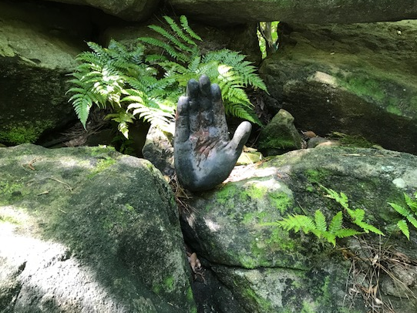

Slide 34
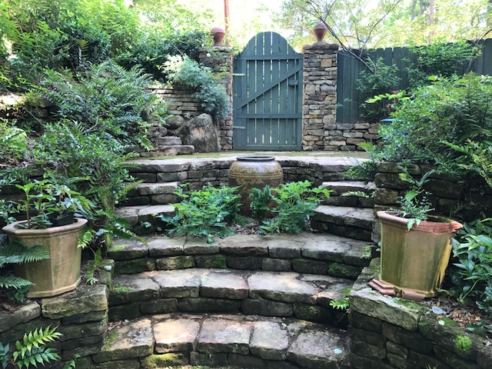

Slide 35
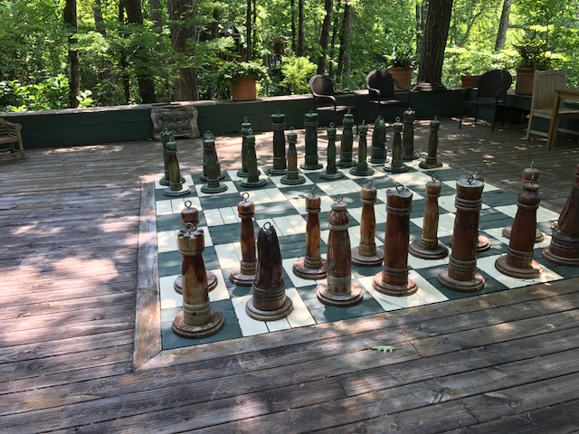

Slide 36
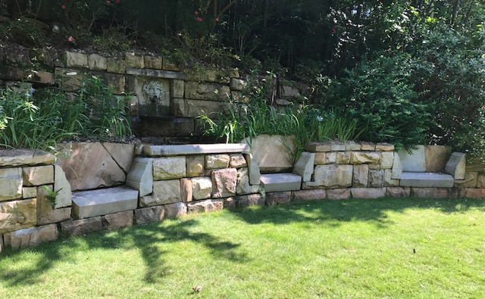

Slide 37
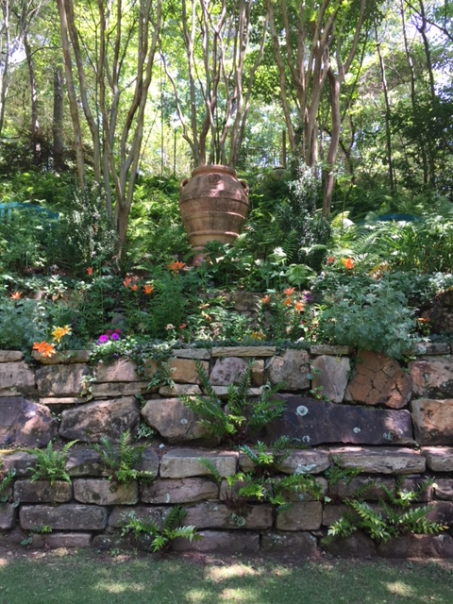
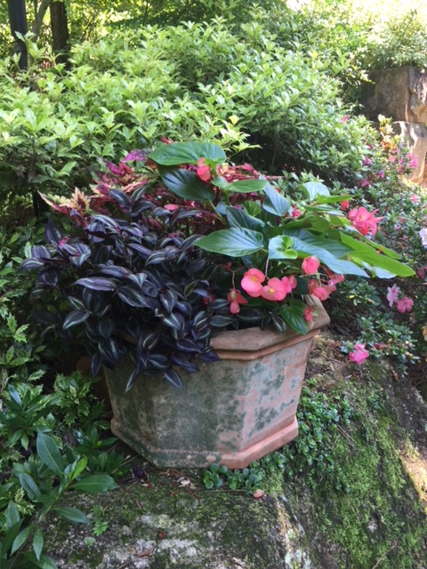

Slide 38
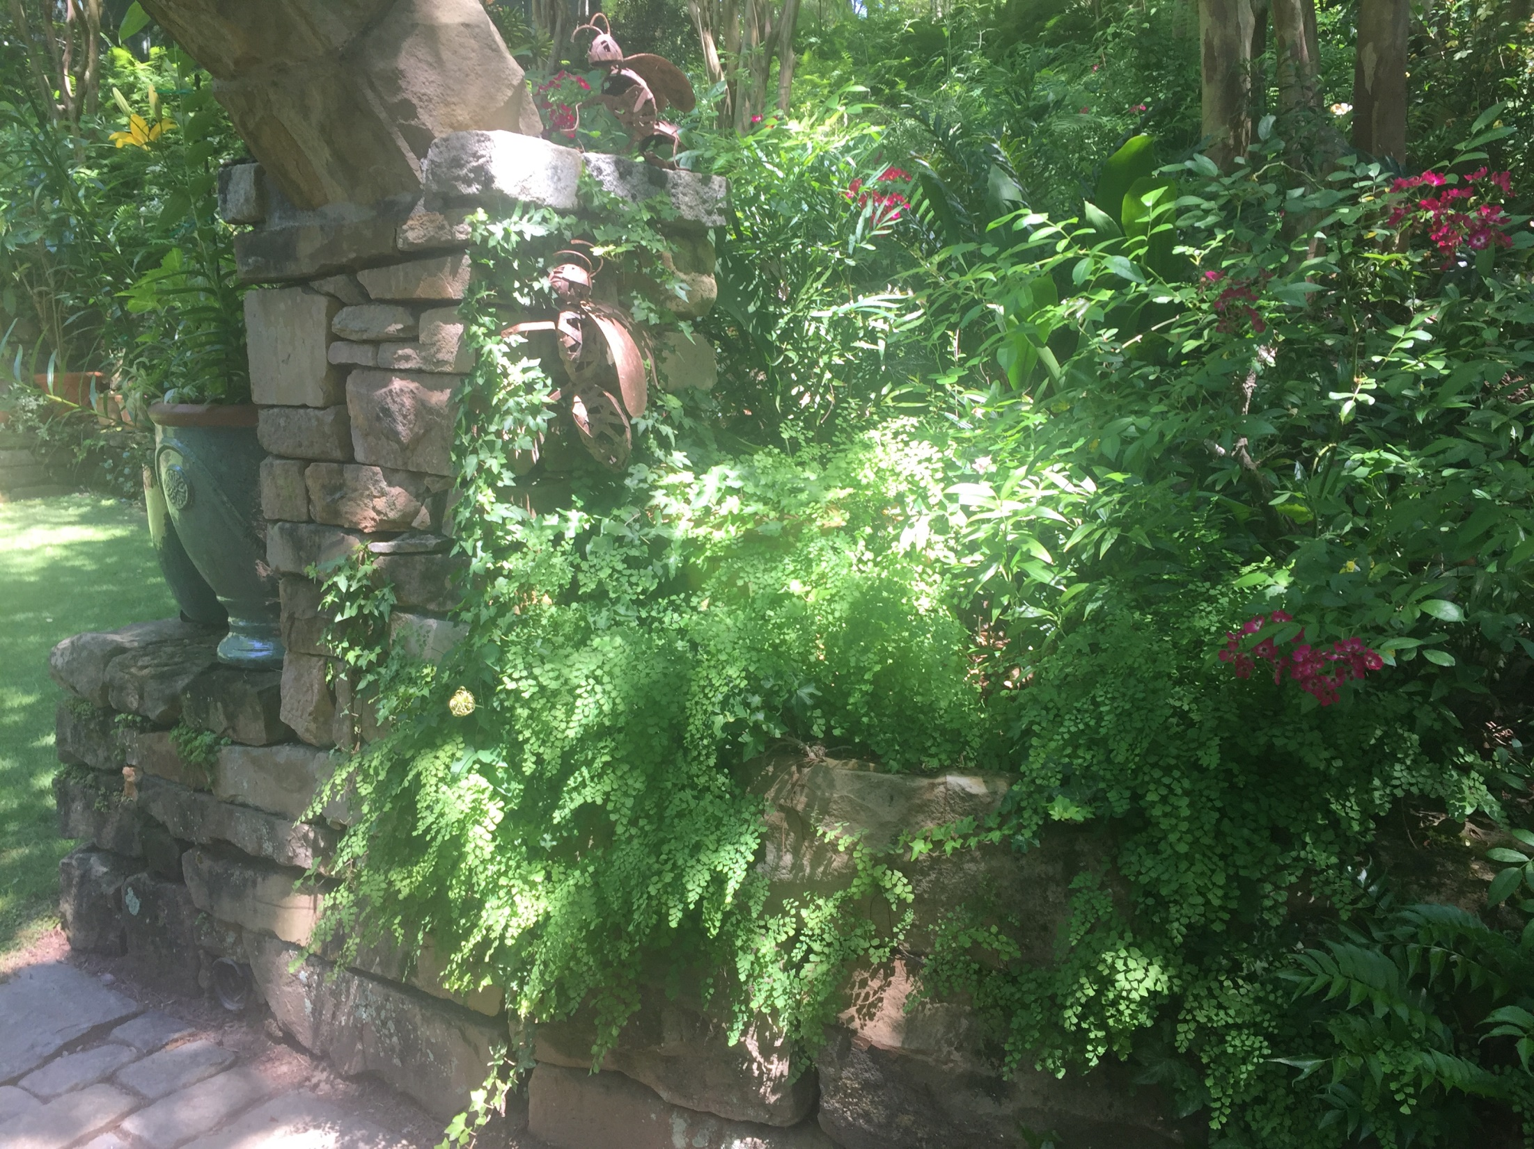

Slide 39
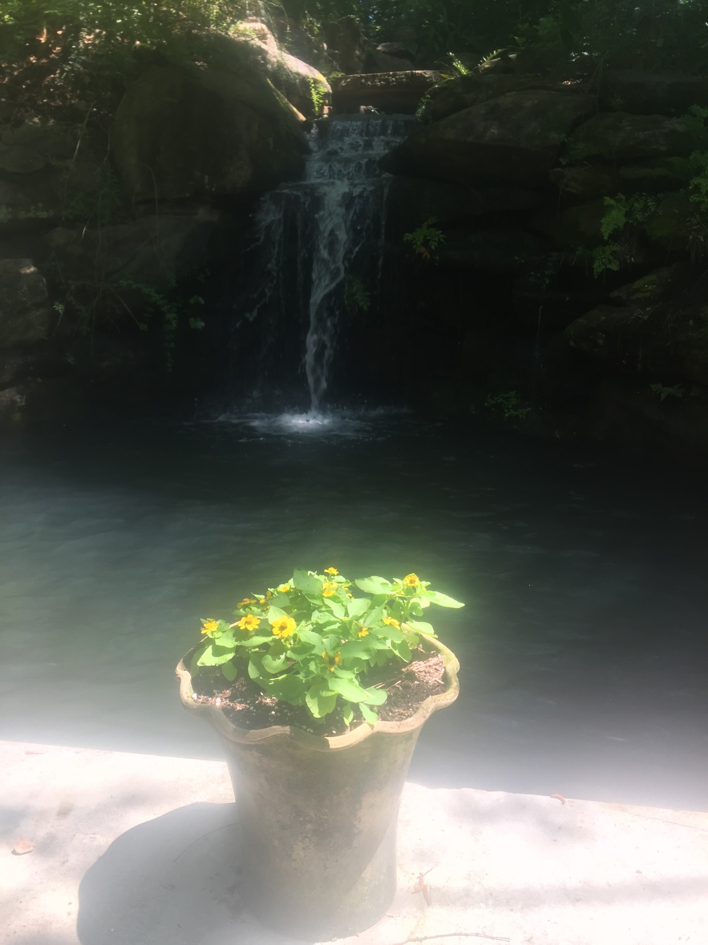
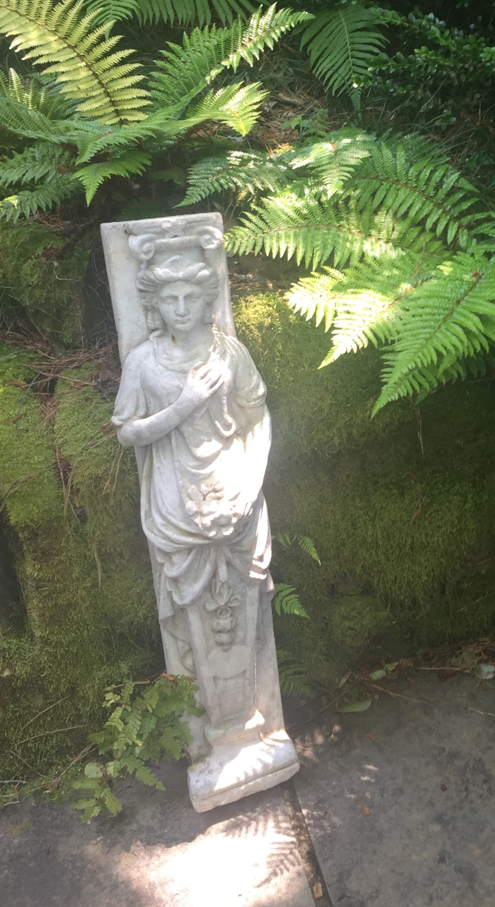

Slide 40
Landscape Design Tip
Good Design Should Lead the Gardener Forward (or at least lead the eye forward).

Slide 41
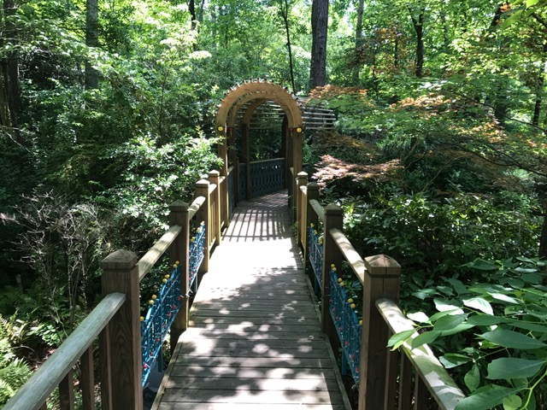

Slide 42


Slide 43



Slide 44



Slide 45


Slide 46


Slide 47
Landscape Design Tip
Good Design Should Present Garden Vistas

Slide 48


Slide 49


Slide 50


Slide 51
Landscape Design Tip
Good Design Should Include Cool Settings

Slide 52


Slide 53


Slide 54


Slide 55


Slide 56
Landscape Design Tip
Good Design Should Include Places to Relax

Slide 57


Slide 58


Slide 59


Slide 60


Slide 61
Wendy White’s Garden
June 17, 2017
Alabama Hydrangea Society Tour

Slide 62

The Tour Group with Our Host

Slide 63

Hillside Garden in Back of House

Slide 64

H. arborescens ‘Annabelle’

Slide 65


Slide 66


Slide 67


Slide 68


Slide 69


Slide 70


Slide 71


Slide 72


Slide 73


Slide 74


Slide 75



Slide 76


Slide 77


Slide 78


Slide 79


Slide 80


Slide 81


Slide 82


Slide 83


Slide 84

Hydrangea serrata ‘Fuji no taki’

Slide 85

Hydrangea mac. Endless Summer
‘Blushing Bride’

Slide 86



Slide 87


Slide 88


Slide 89


Acer griseum -- Paperbark Maple

Slide 90

H. macrophylla ‘Beaute vendomoise’?

Slide 91


Slide 92

H. quercifolia ‘Little Honey’

Slide 93



Slide 94



Slide 95



Slide 96

Phyllis Love

